Slide 1


Leading Digital Marketing in 2015
Reviewing the State of Digital Transformation
Dr Dave Chaffey. SmartInsights.com
Presented at Technology for Marketing & Advertising, London.
Download: http://bit.ly/smartdigital2015

Slide 2
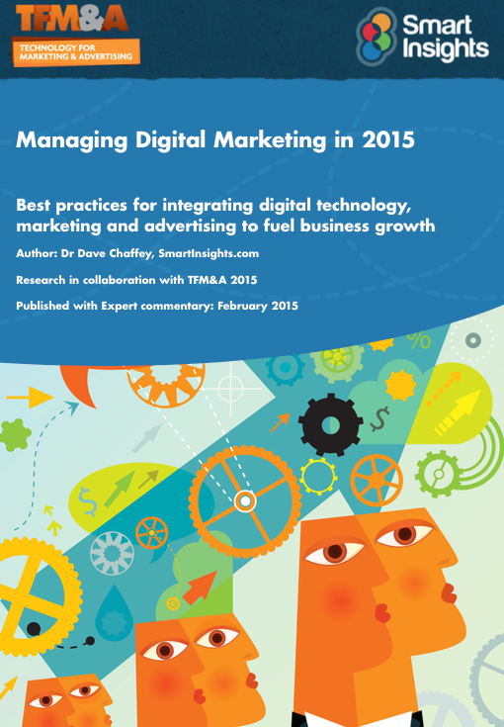
AGENDA 1. Digital Capabilities 2. Digital Strategy 3. Transformation 4. Resourcing and skills 5. Investing in digital 6. Innovation and Optimisation Roundtables
McKinsey 7S Model

Slide 3
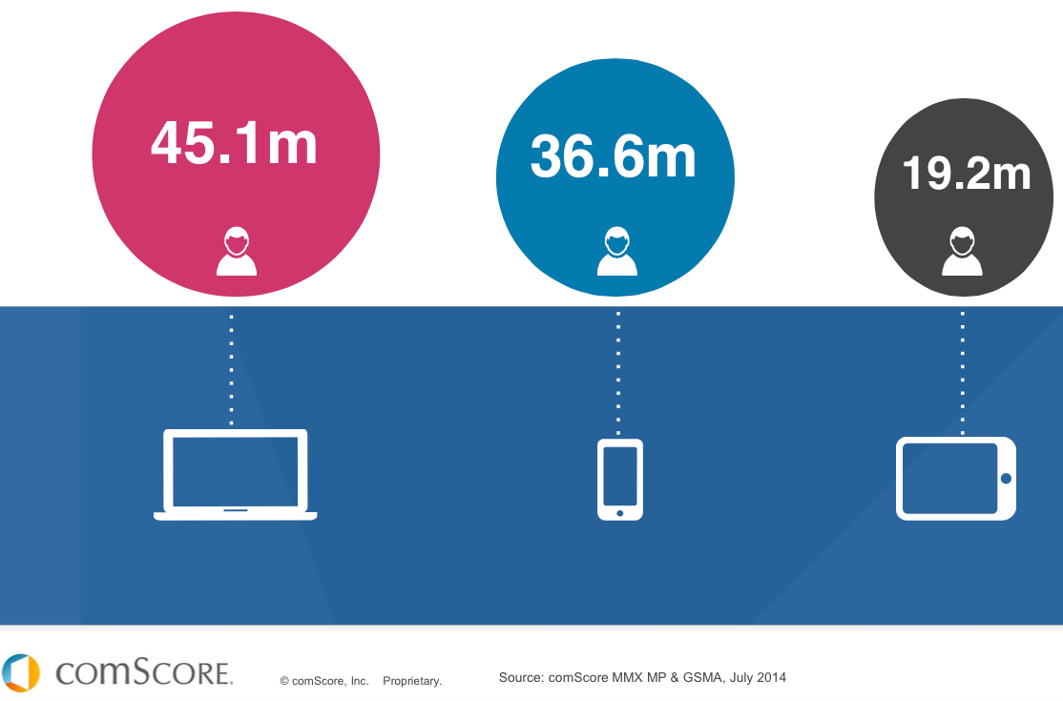
Mobile tipping point passed

Slide 4
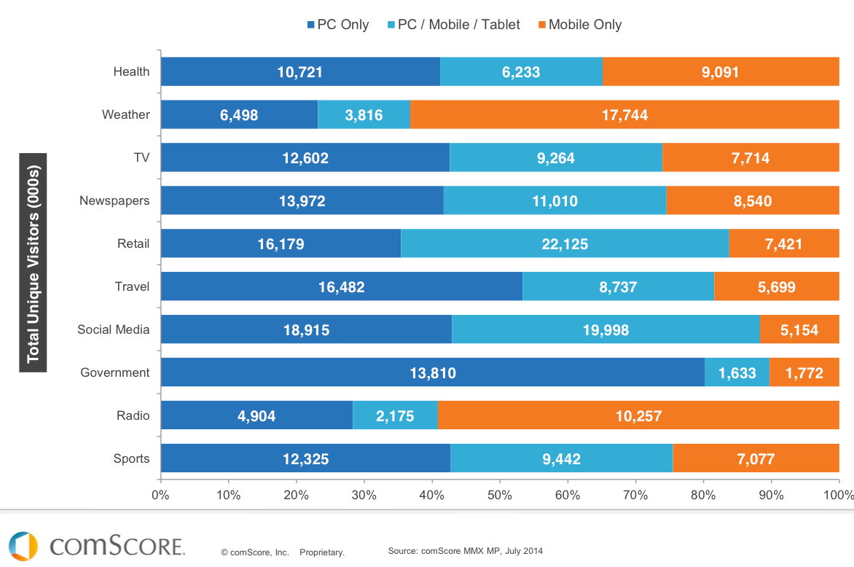
Source: comScore Multiplatform Majority

Slide 5
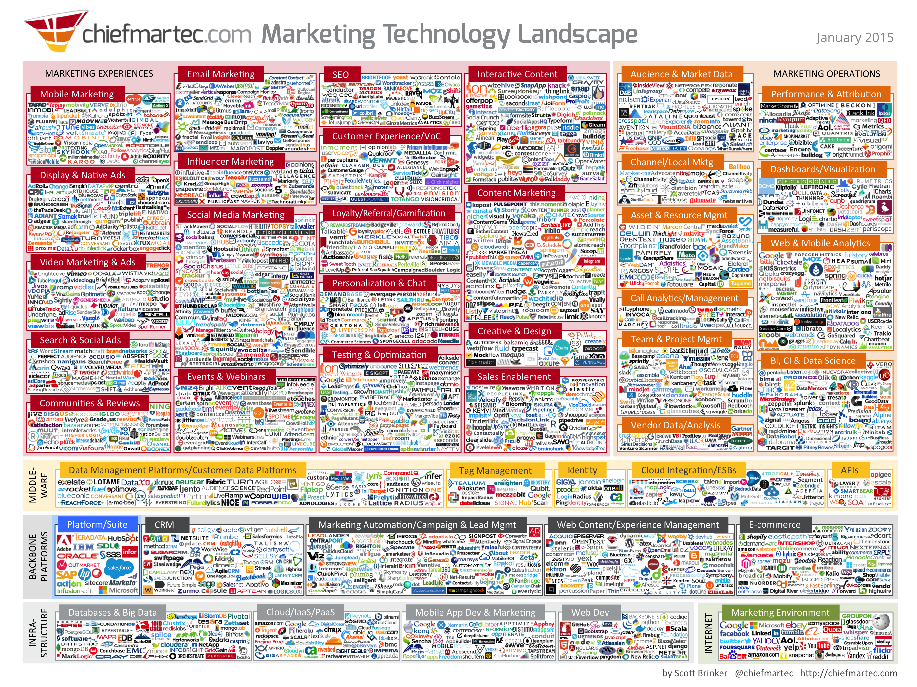

Slide 6
Introductions
Your name, role and company
Select your primary digital / multichannel challenges
1.Plan – Creating Digital Strategies and refining business models
2. Plan – Managing Digital Transformation (structural changes, skills)
3. Reach – Gaining incremental awareness based on budget allocation
4. Act – Proving/delivering Content (SM) Marketing ROI
5. Convert – Conversion rate optimization (CRO) + Multichannel
6. Engage – Improving Customer contact strategies and Customer Experience Management (CXM) using Marketing Automation for email, social, web and mobile
All are multichannel and multiplatform (mobile). Other??

Slide 7

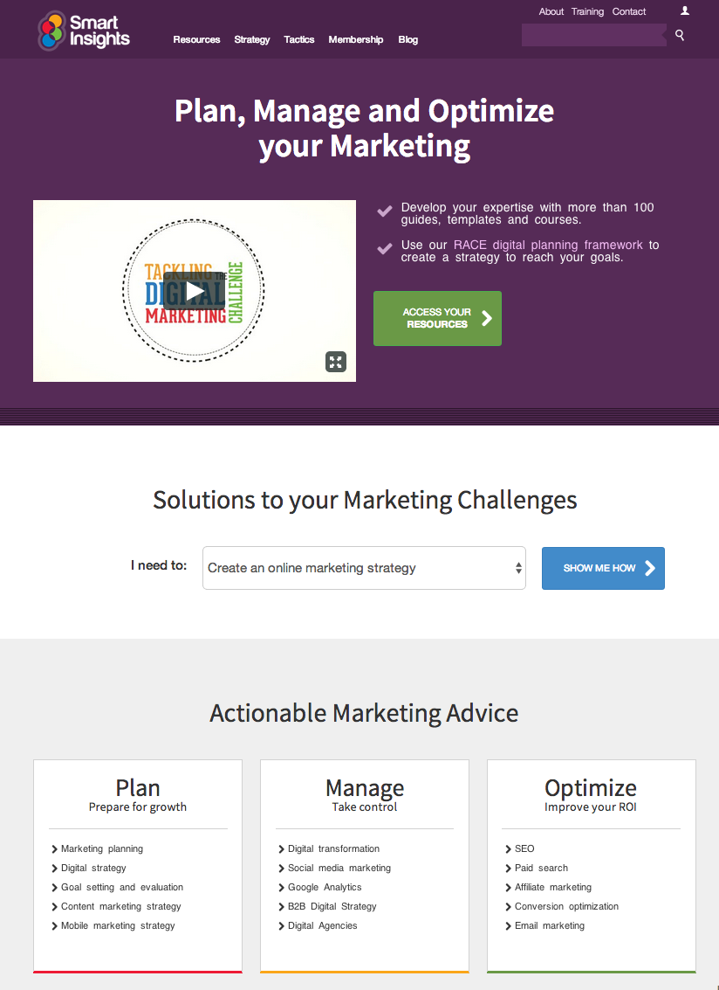
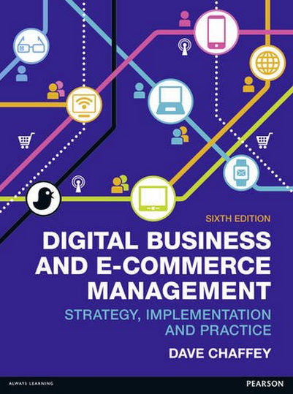

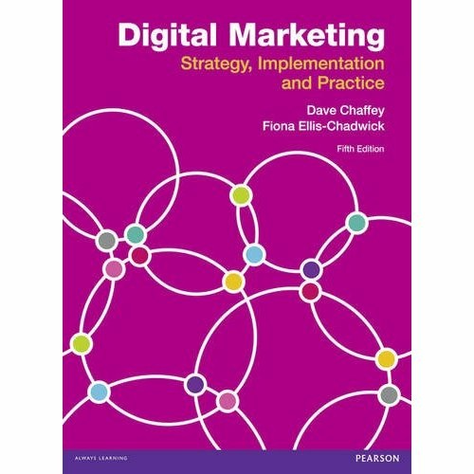
About Dave
About Dave Chaffey
Consultant and trainer in Digital since 1997
Author of 5 bestselling digital marketing books
CEO and Editor of SmartInsights.com - a marketing advice site with Expert (Pro) members in over 50 countries using our templates, planning guides and online courses to improve results.

Slide 8
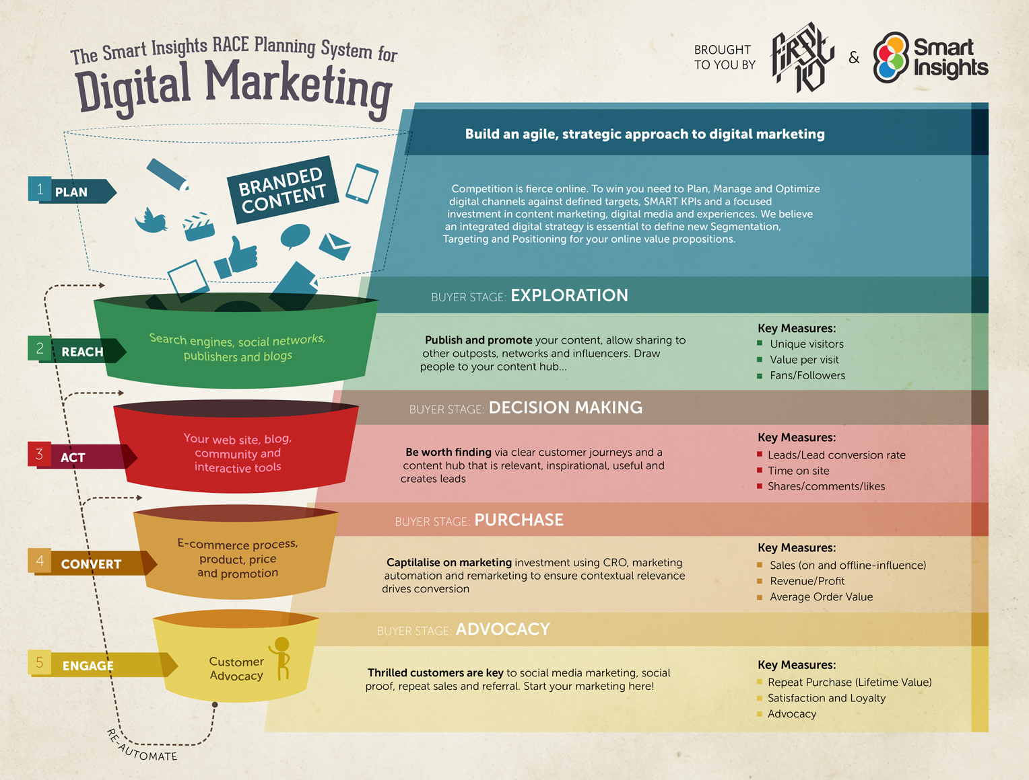

Slide 9
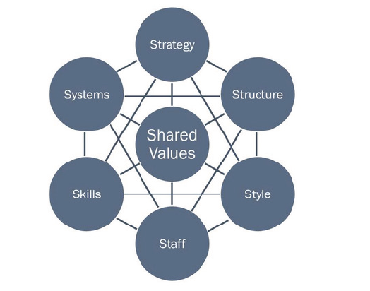
ONE Digital marketing Capabilities
McKinsey 7S Model

Slide 10
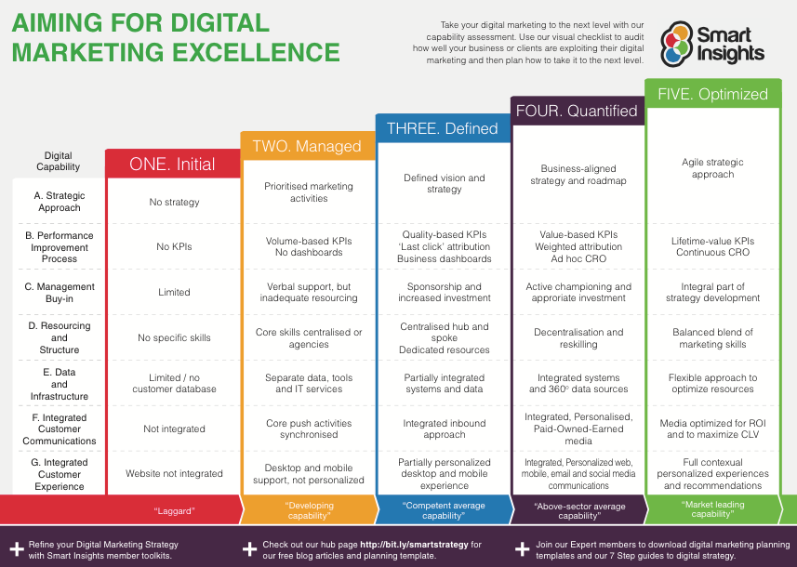
How advanced are your digital marketing capabilities?
To download a larger version of the capability matrix:
http://bit.ly/smarttransformation
Notes:
To fuel growth you need to be honest about where you are now.

Slide 11
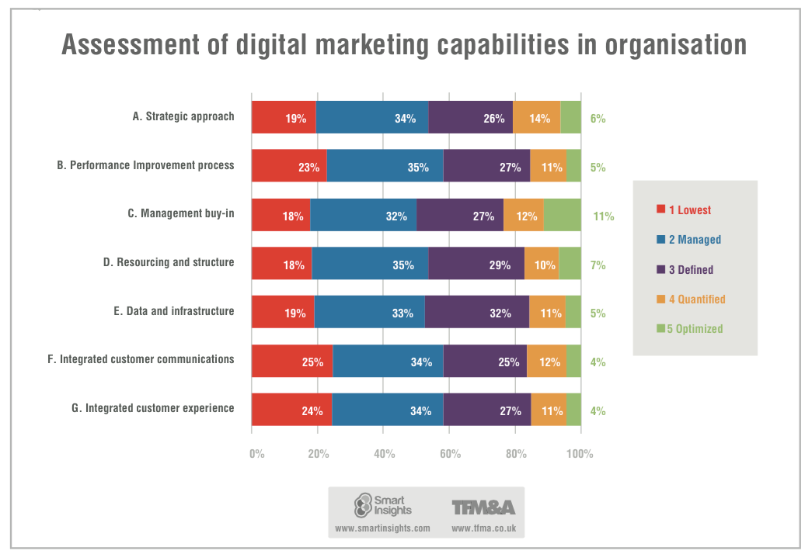

Slide 13
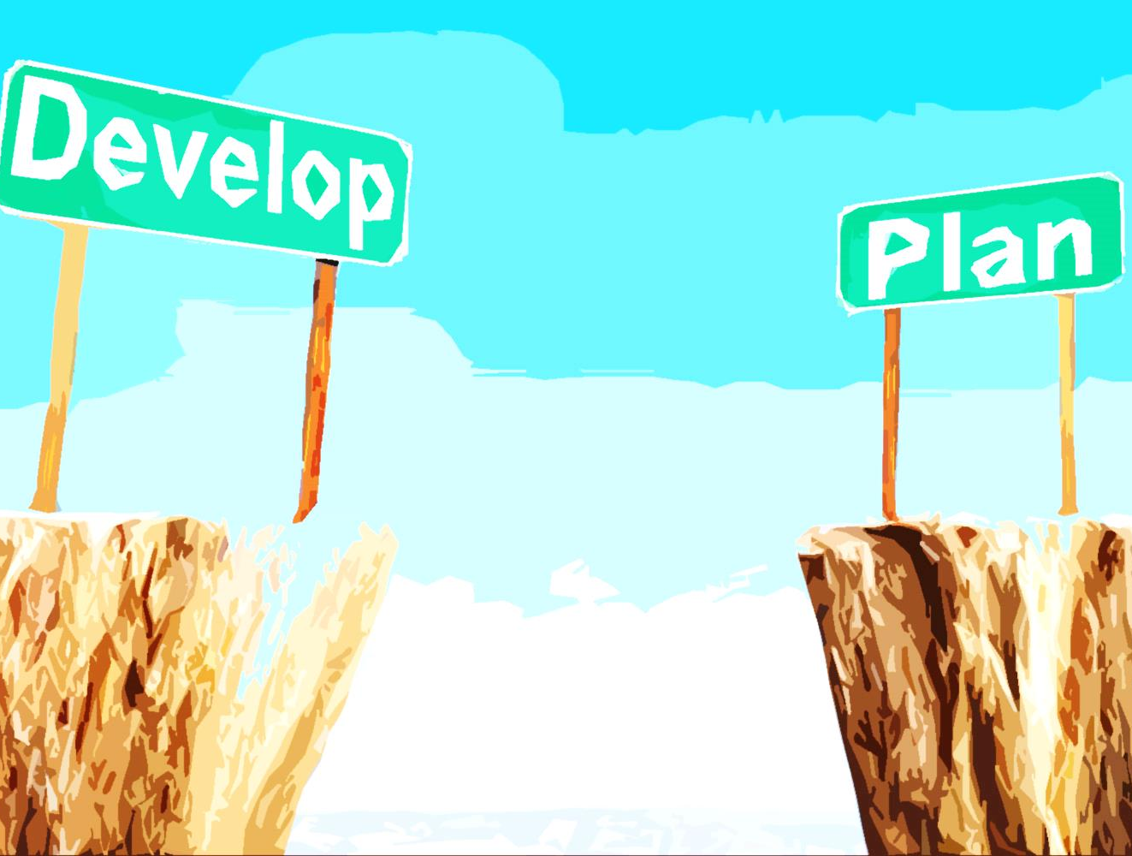
STEP 1b - Create a Monthly Planning Framework
Email 'Type' | Customer Lifecycle Segmentation
 | Prospects | Nursery | Development | Lapsing | Lapsed
Lifecycle | P2C programme | Nursery programme | Spot the winners | Prevent Lapsing programme | Lapsed programme
Behavioural | Triggered by customer behaviour: ABBA, BnB, Accessories etc (max.1 email per week for each programme)
Newsletter | Sent wk. 1 each month to all contacts with personalised content
Feature Email | Sent wk. 2 each month to all contacts
Offers and Deals | Sent wk. 3 each month to all contacts
NPI | Sent wk. 4 each month to all contacts
Source: Harriet Mitchell Smart Insights 2014 Digital Impact conference

Slide 14
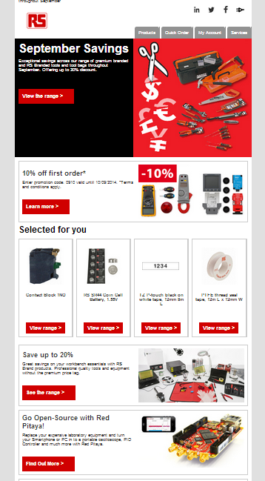
The RS Newsletter
Customised content: (Customer Profile)
EDE (Electronic Design Engineers)
Non-EDE (Electronic Design Engineers)
Promo Excluded (Key and Corporates)
Hero banner
Customised content: (Customer Lifecycle)
Nursery
Development
Acquisition
CLC Module
Customised content: (Behavioural data)
Abandoned Baskets
Browsed Not Bought
Propensity to Buy (A recommendations model)
Top Sellers
BEH Module
Product Modules
Product modules can vary in number and format. Maximum of 8 modules per email.
Local Module
Optional modules for any local activity/information.
Source: Harriet Mitchell Smart Insights 2014 Digital Impact conference

Slide 15
The multiplatform majority?

Slide 16
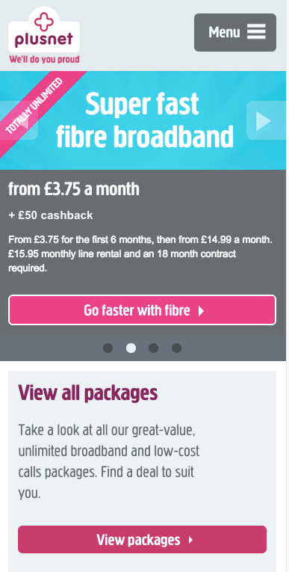
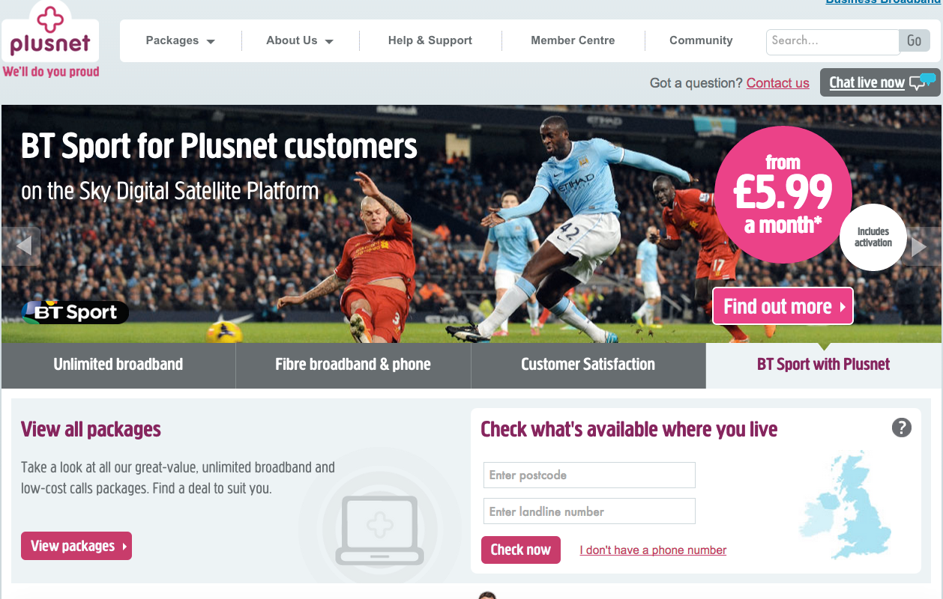
Is mobile responsive sufficient?

Slide 17
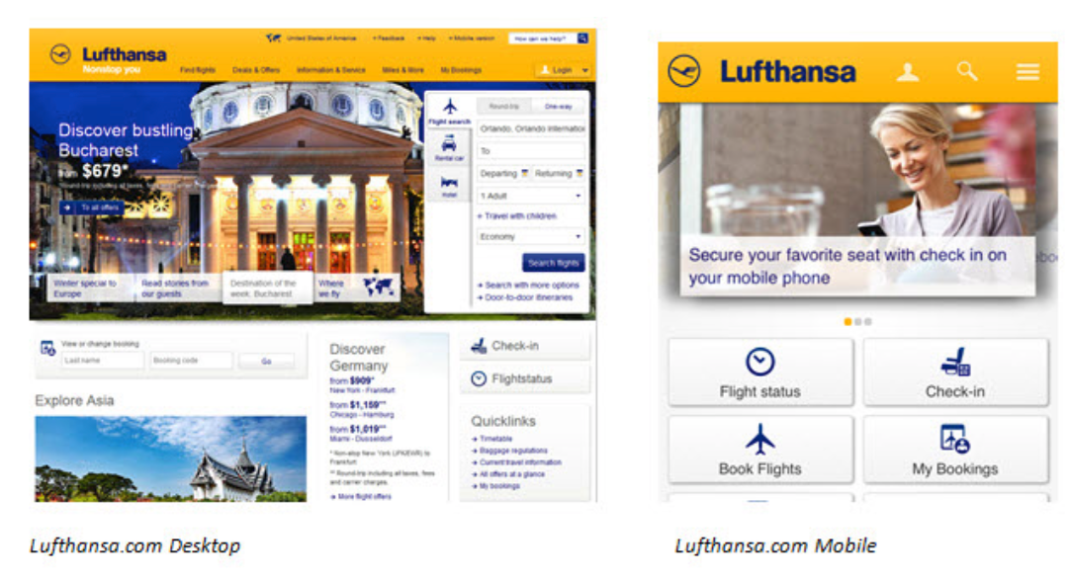
Or is adaptive needed?

Slide 18
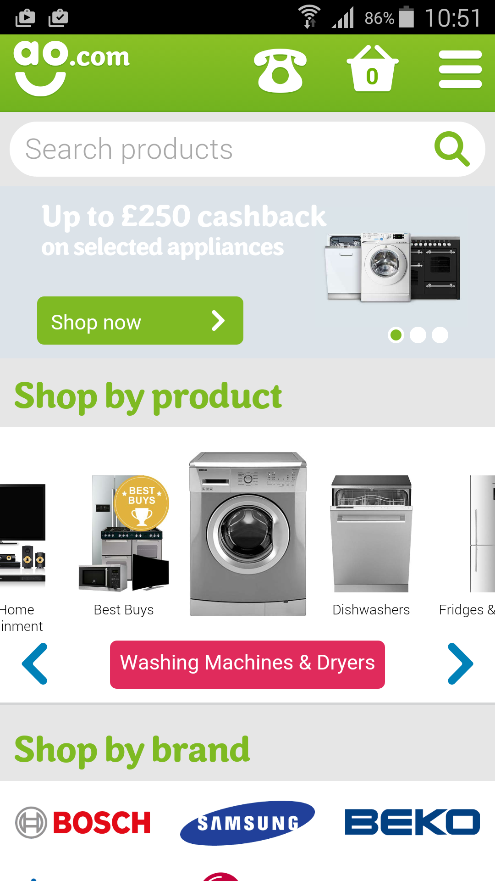
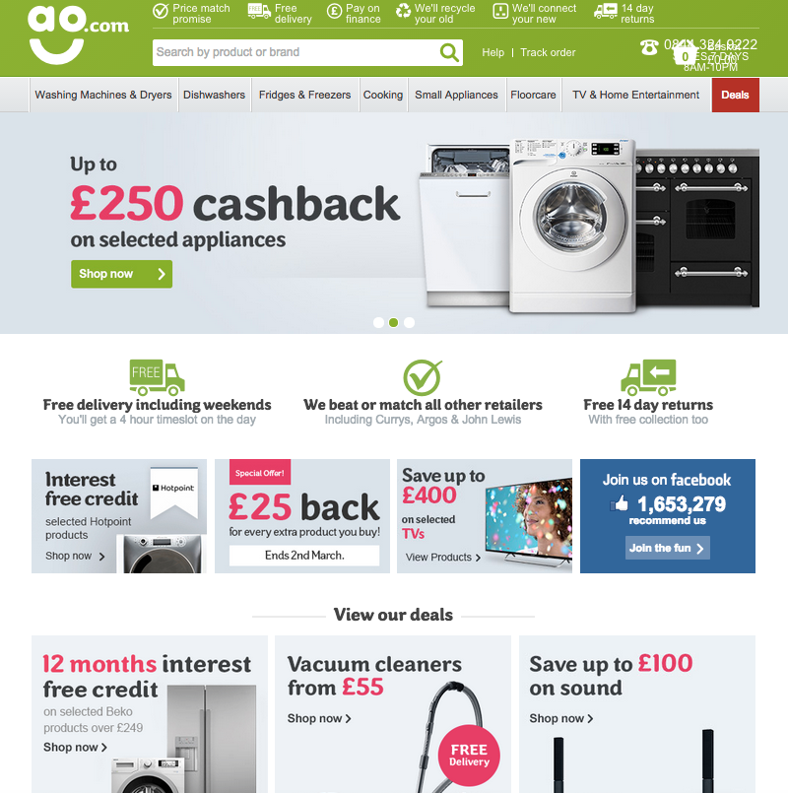
AO.com adaptive

Slide 19
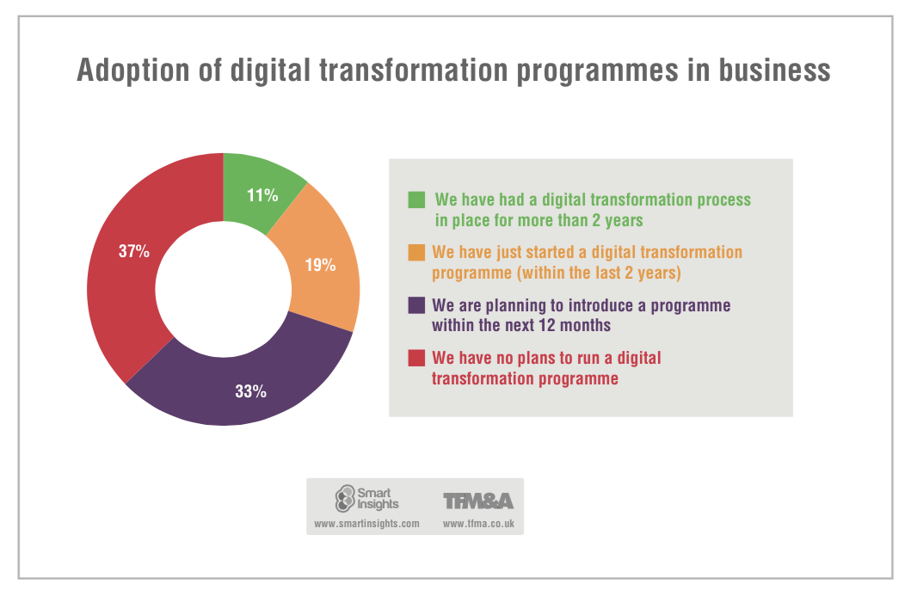

Slide 20
TWO Strategy and Planning

Slide 21
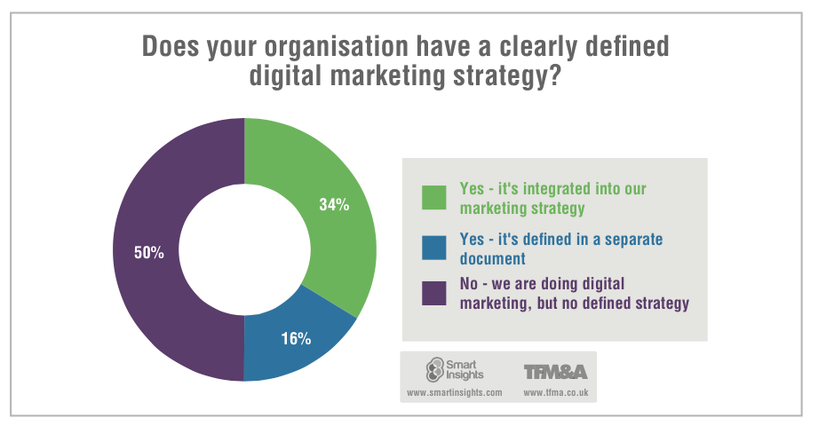
Do you need a defined digital strategy or plan?

Slide 22
THREE Resourcing Digital Marketing

Slide 23
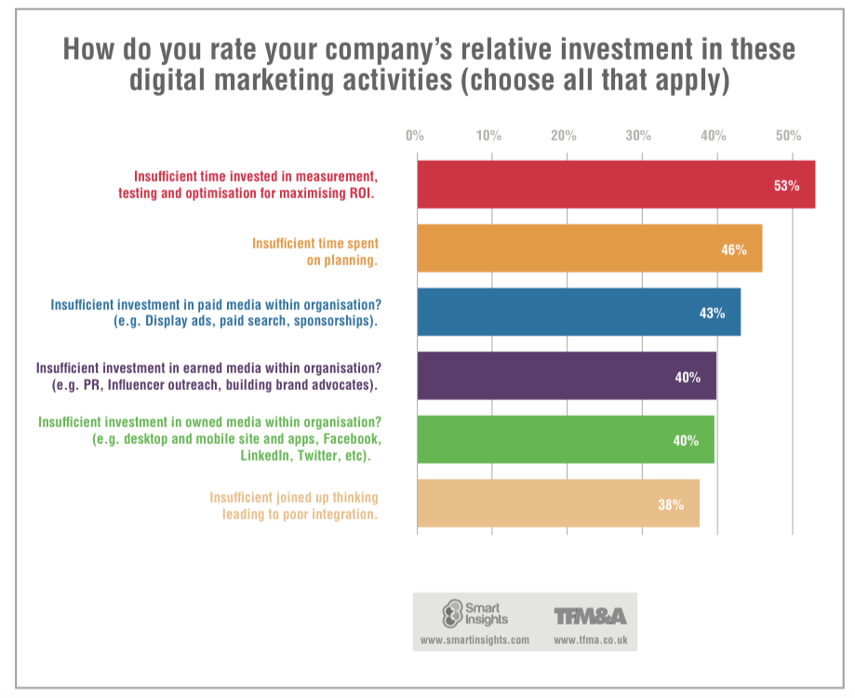

Slide 24
FOUR Managing change and skills development

Slide 25
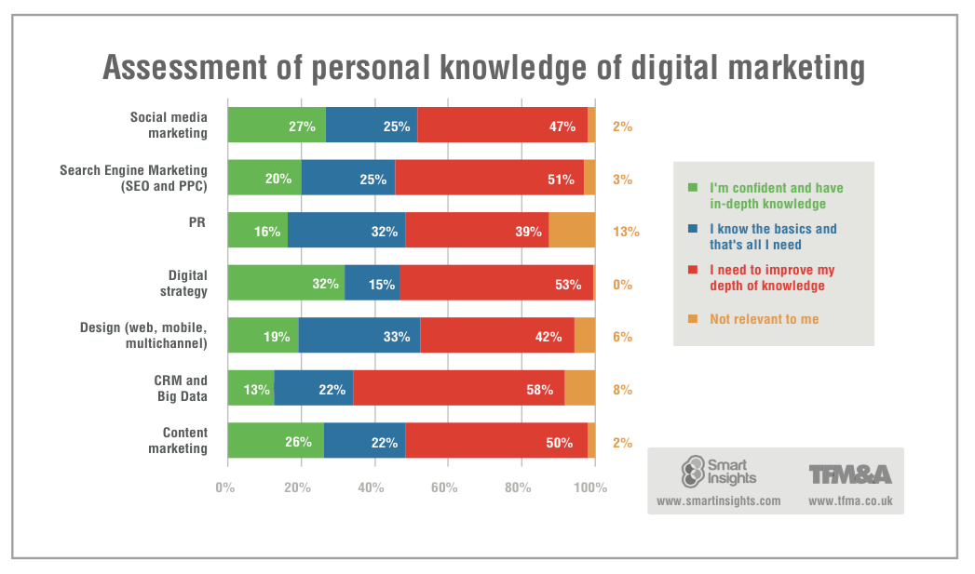

Slide 26
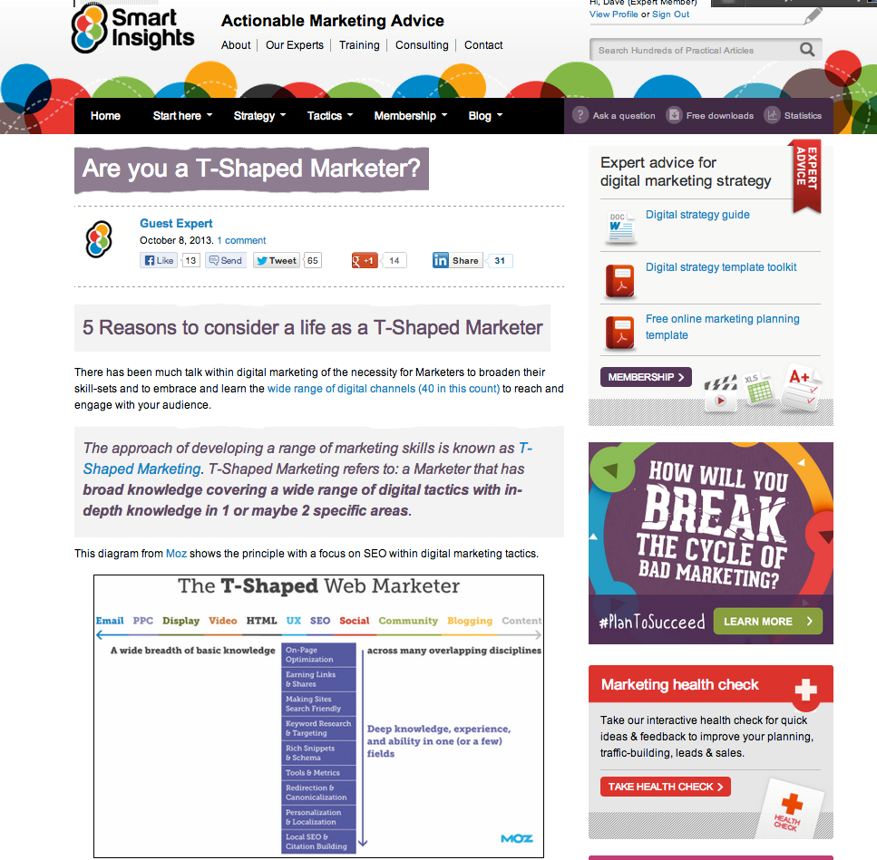
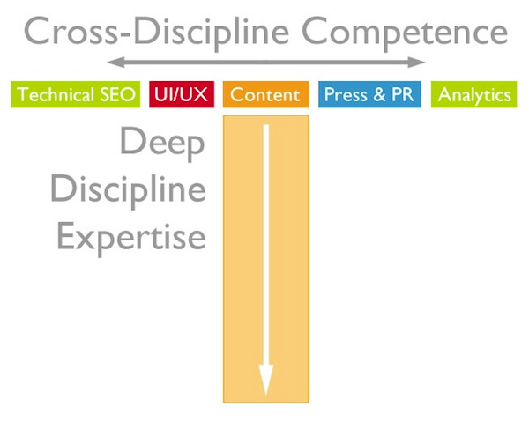
From T-Shaped to V-Shaped

Slide 27
FIVE Investing in Digital Marketing

Slide 28
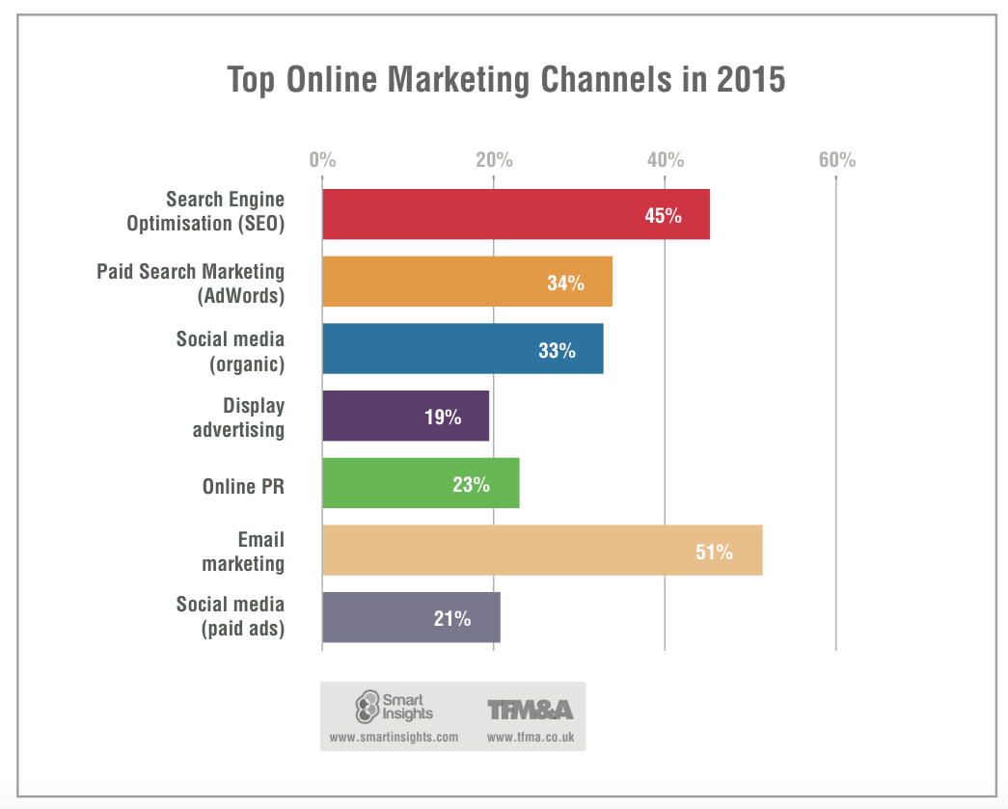
% rated medium-high or high?

Slide 29
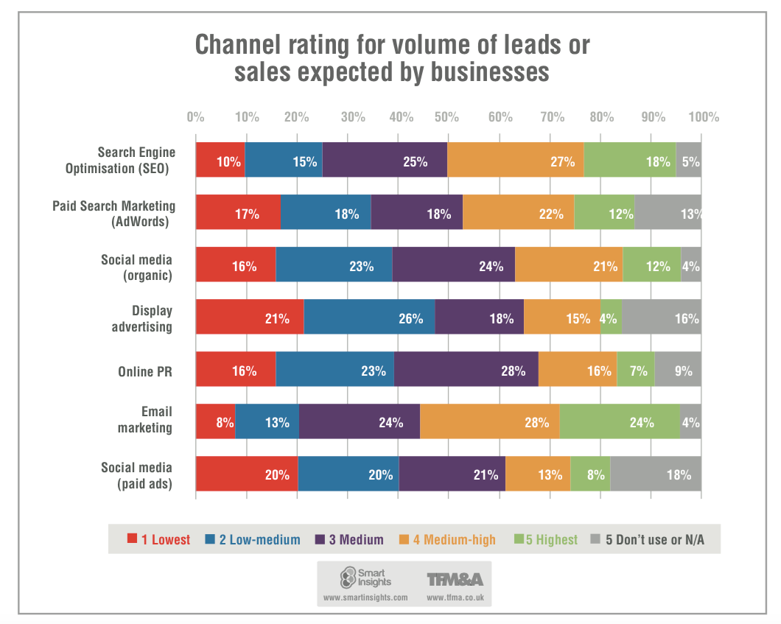

Slide 30
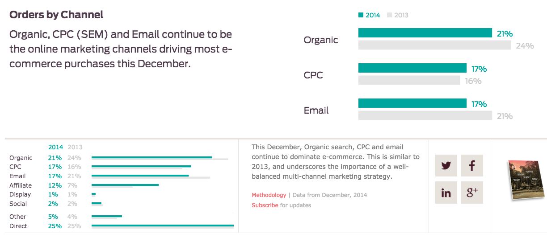
Source: Custora Pulse

Slide 31
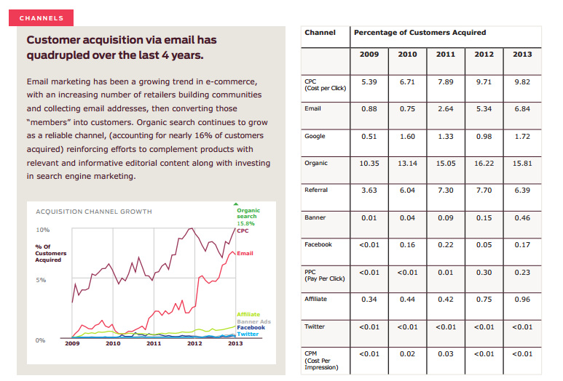
Source: Custora Pulse

Slide 32
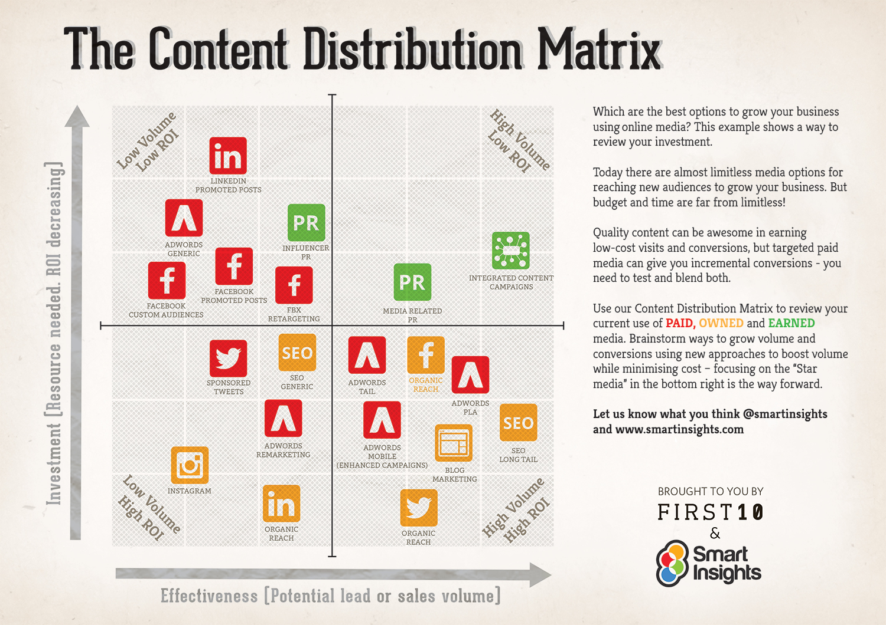

Slide 33
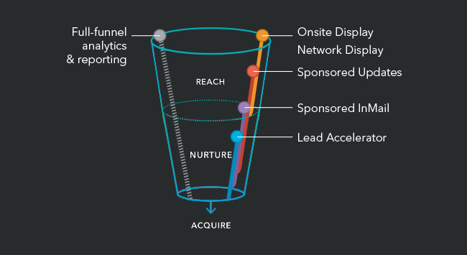
Retargeting + SNS innovation
Our buyers live online and consult their networks to research potential purchases. According to Forrester Research, up to 90% of a buyer’s path to purchase is completed before a salesperson comes into the picture. But…
95% of website visitors never provide an email address to marketers.
2. Of the 5% who do, only about 20% open the prospecting emails they get afterwards.
3. Bottom line: most marketers are converting less than 1% of all possible leads.
Source: LinkedIn

Slide 34
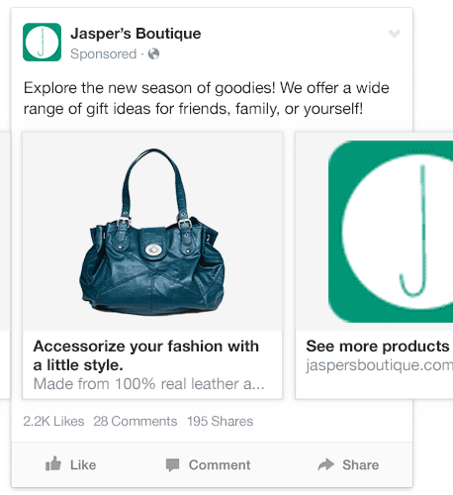
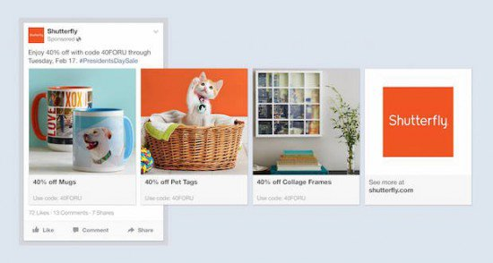
New Facebook retail retargeting
Source: Smart Insights alert

Slide 35
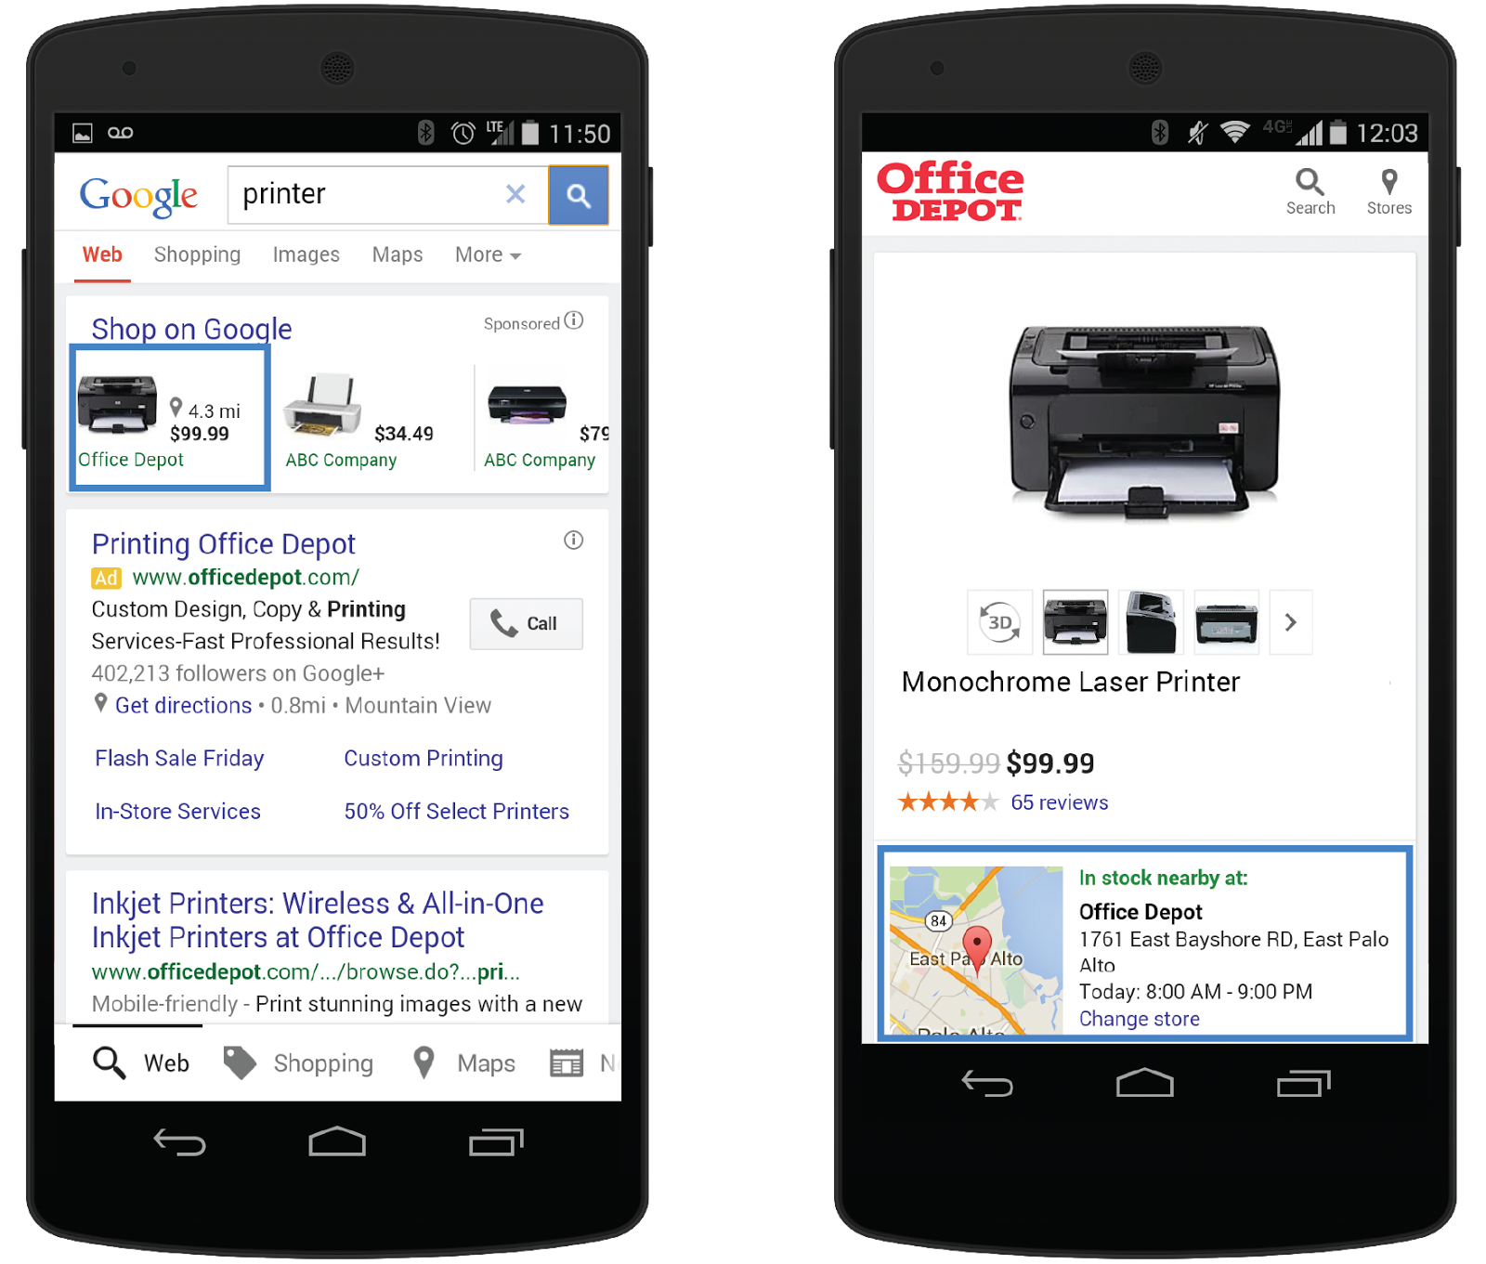
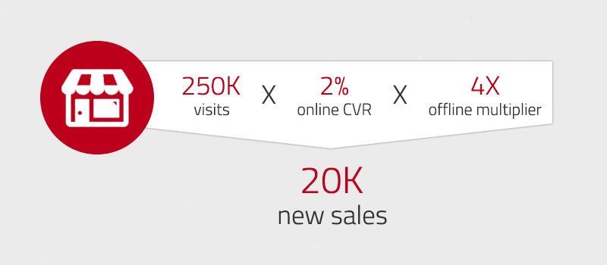
Assessing ROPO impact
New - AdWords Estimated Total Conversion

Slide 36
SIX Innovation and Optimisation

Slide 37
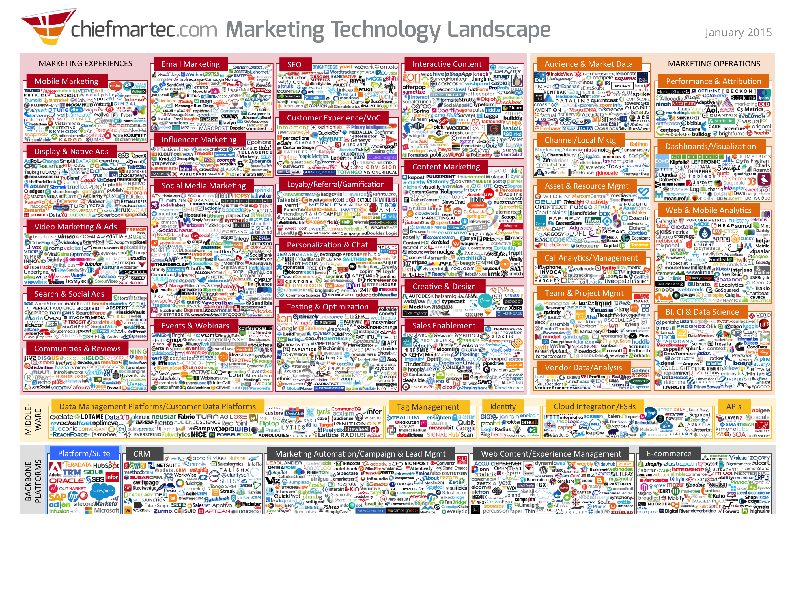
Marketing Technology in 2015 – Scott Brinker Technology Landscape

Slide 38
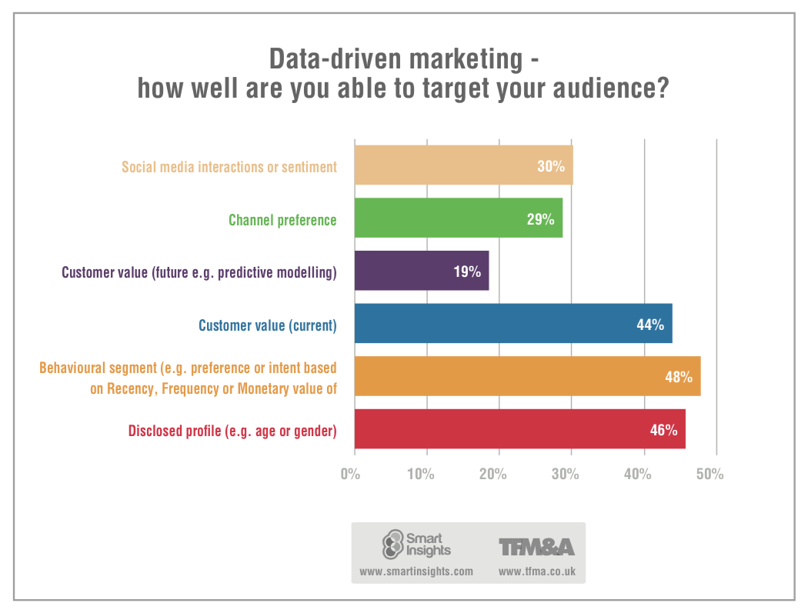

Slide 39
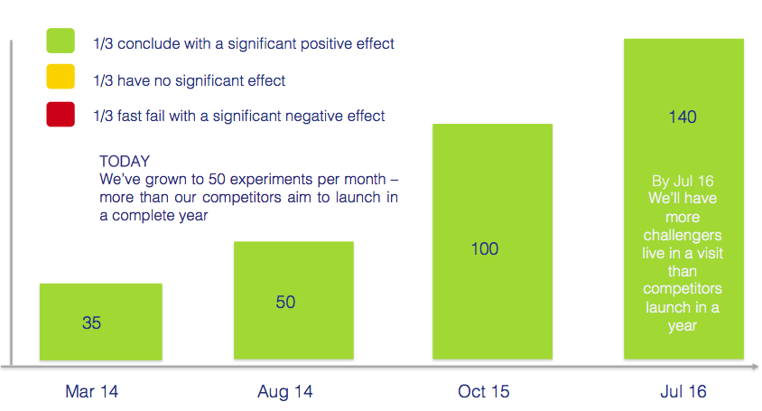

Mindset: Optimize or Die!
Presented by Deputy CEO, Gareth Jones at Ecommerce Expo

Slide 40
Roundtables
Please identify chair(s) and presenter(s), then
Discuss the key strategic questions you’re tackling:
1.Plan – Creating Digital Strategies and refining business models
2. Plan – Managing Digital Transformation (structural changes, skills)
3. Reach – Gaining incremental awareness based on budget allocation
4. Act – Proving/delivering Content (SM) Marketing ROI
5. Convert – Conversion rate optimization (CRO) + Multichannel
6. Engage – Improving Customer contact strategies and Customer Experience Management (CXM) using Marketing Automation for email, social, web and mobile
All are multichannel and multiplatform (mobile). Other??

Slide 41
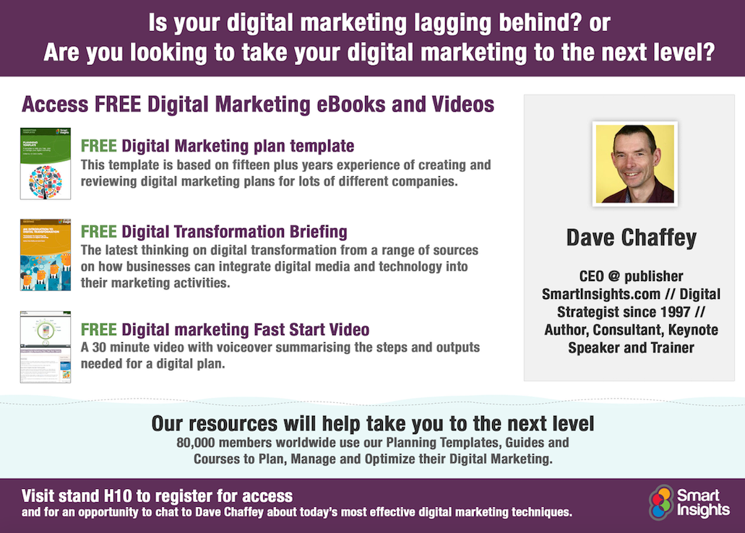

Slide 42





Let’s Connect! Questions & discussion welcome on Stand H10 or SmartInsights.com
uk.linkedin.com/in/davechaffey
www.facebook.com/davechaffey
www.twitter.com/DaveChaffey
https://plus.google.com/+DaveChaffeyUK/
Free, Basic member tools
Managing Digital Marketing 2014 report
Managing Customer Experiences 2014 report
Sample planning templates
Planning infographics www.smartinsights.com/membership
Premium, Expert member learning
7 Step Guides to all digital marketing
DIY Planning and optimisation templates in Word, Excel and Powerpoint
www.smartinsights.com/membership/expert-member-reasons
Presented at Technology for Marketing & Advertising, London.
Download: http://bit.ly/smartdigital2015

